Slide 1
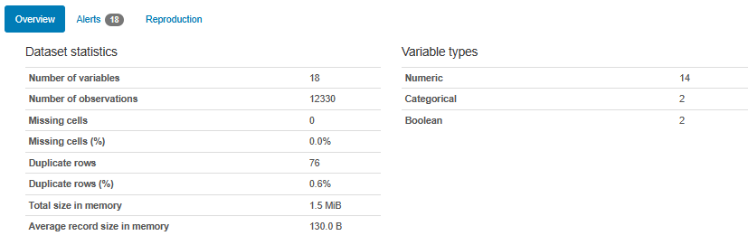
Online Shoppers Intentions
This is the data of an online retailing company where they are trying to find which online shopper will generate revenue by his/her online shoppers’ activity on their site.
The following are the variables given to us :
'Administrative', 'Administrative_Duration', 'Informational', 'Informational_Duration', 'ProductRelated', 'ProductRelated_Duration', 'BounceRates in %', 'ExitRates in %', 'PageValues', 'SpecialDay (probability)', 'Month', 'OperatingSystems', 'Browser', 'Region', 'TrafficType', 'VisitorType', 'Weekend', 'Revenue‘
As we want to know whether customer have generated revenue or not, our output/target variable is ‘Revenue’.
As we have output/target variable it is a Supervised Machine Learning model.
As the variable Revenue is of Boolean type, we can say it is a classification problem.
By using pandas profiling we came to know that

Slide 2
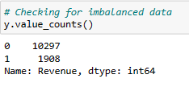
Online Shoppers Intentions-(1)
Preprocessing:
Missing values: From the overview we came to know that no missing values are there
Duplicates rows removal: most common duplicated rows are given in overview. We need to remove the duplicate rows which may result in reduced performance
Label encoder: We need to convert the categorical and boolean variable types to numerical using label encoder.
Outlier removal: Except 2 or 3 variables all the other variables are having outliers. Instead of treating each variable for outlier. We can do feature scaling to all the variables
Feature scaling: We are using Standard Scaler for scaling as there are outliers
Imbalance dataset: As we can see the data is imbalanced from the below picture. We are making it balanced using RandomOverSampling.
By using Random Forest Model we got the highest F1 score.

Slide 3
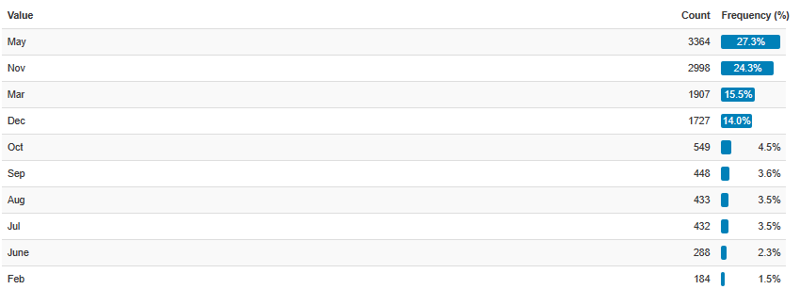
General Analysis on Data
From the data we can see that we have only details for 10 months. Where January and April months are missing.
We can see that most of the activities occurred in the months of May, Nov, Mar, Dec which is about 81% where the rest of 19% activity happened in the rest 6 months.

Slide 4
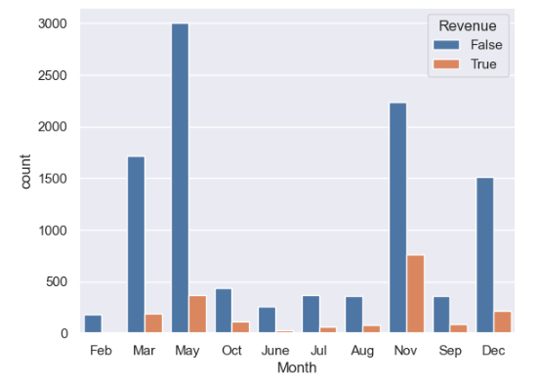
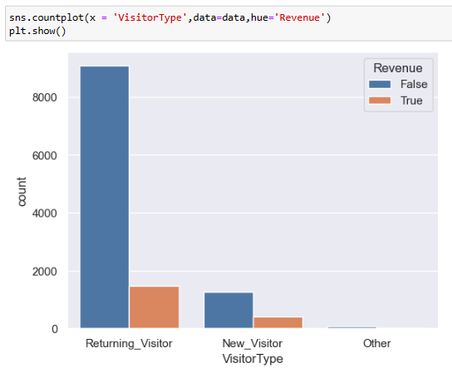
General Analysis on Data-(1)
Though highest online shoppers activities were in May, but the highest revenue generated was in November
Most of the online shoppers activities were done by Returning_customers and the maximum revenue generated by Returning_customers

Slide 5
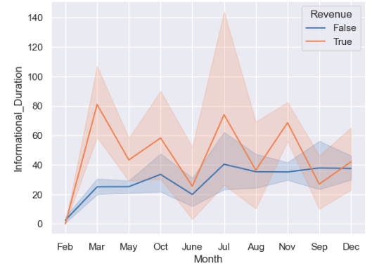
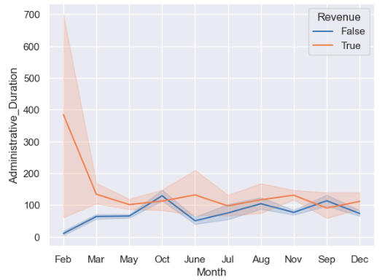
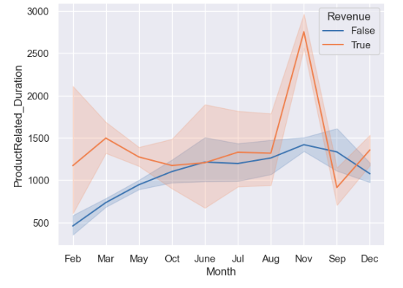
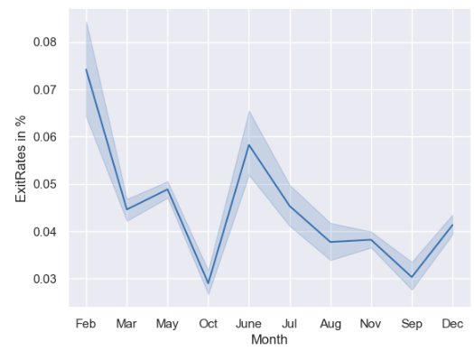
General Analysis on Data-(2)
The customers whose duration of time in Administrative_duration , ProductRelated_Duration, Informational_Duration is more have generated revenue.
Exit Rates are high in the month of Feb and June

Slide 6
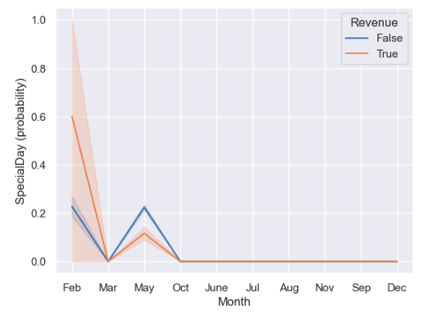
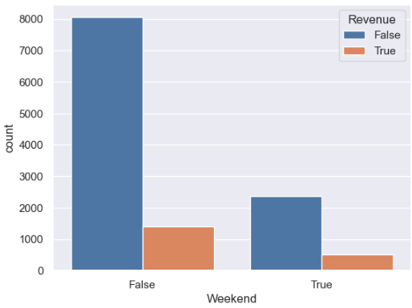
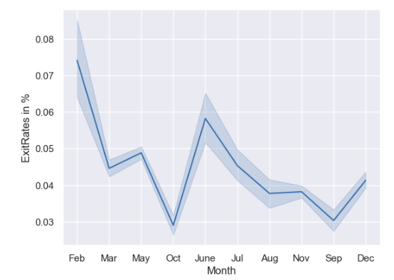
General Analysis on Data-(3)
Only in the month of Feb, the Revenue generated on SpecialDay was highest
Revenue generated on Weekday is more than in Weekend
Exit rates in Feb and June are more which is negligible , as the activities in Feb and June are less than 4%

Slide 7
Conclusion
As the Revenue generated in the month of November is highest. We should look into the offers, new products or products which have been sold in that month, so that we can try in other months to increase the revenue.
Special days and weekends are not contributing much for the generation of revenue, We should relook into the offers or items available for those particular days.
We should concentrate more on retaining the Returning_visitor by giving them offers or bonus points for the next purchase.
Give special discounts if Returning_visitor introduces new_visitors who purchase an item.

